Slide 1
A Brief Introduction to the Game of Life
Notes:
What’s the problem? problem specification
Like a chessboard of gobang.
what to do?
How to do?
For a living cell ,if it has 2 or 3 living neighbors, it will be still living;
if it has 0 or 1 living neighbors, it will die in the next generation.

Slide 2
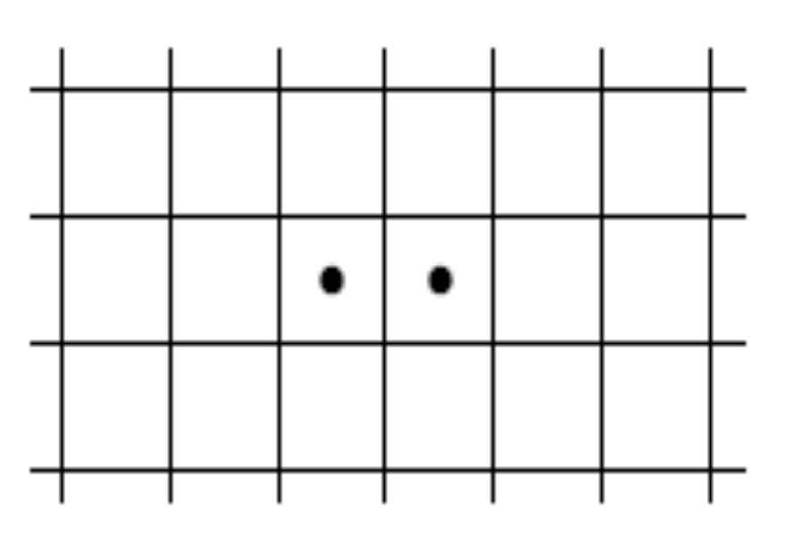
Example demonstration
——game of life
Rules for the game of life
Definition
  It takes place on an unbounded rectangular grid in which each cell can either be occupied by an organism or not.
  Occupied cells are called alive; unoccupied cells are called dead.
  Which cells are alive or not changes from generation to generation according to the number of neighboring cells that are alive, as follows:
Notes:
What’s the problem? problem specification
Like a chessboard of gobang.
what to do?
How to do?
For a living cell ,if it has 2 or 3 living neighbors, it will be still living;
if it has 0 or 1 living neighbors, it will die in the next generation.

Slide 3
Rules of the Game of life
  1. The neighbors of a given cell are the eight cells that touch it vertically, horizontally, or diagonally. Every cell is either living or dead. (only two states)
  2. A living cell stays alive in the next generation if it has either 2 or 3 living neighbors; it dies if it has 0, 1, 4, or more living neighbors. (for a living cell, conditions of still living and die)

Slide 4
Rules of the Game of life
  3. A dead cell becomes alive in the next generation if it has exactly three neighboring cells, no more or fewer, that are already alive. All other dead cells remain dead in the next generation. (for a dead cell when the state will be change?)
  4. All births and deaths take place at exactly the same time.
Notes:
For a dead cell ,if it has just three living neighbors, it will become alive, in all the other conditions, it will remain dead.
If one Cell come alive in the

Slide 5
Configuration
A particular arrangement of living and dead cells in a grid is called a configuration.
Applying the preceding rules, an initial configuration changes to another at each generation.
Notes:
在栅格中的一个特定的布局称为一个配置或格局。

Slide 6
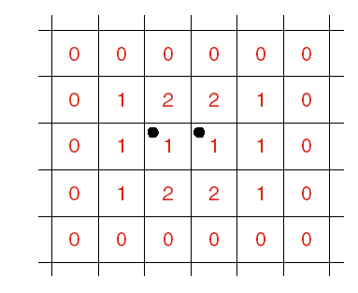
Examples
Moribund (濒死) example
By rule 2 and 3, the living cells will die in the coming generation, and no cells will become alive, so the configuration dies out
Notes:
Let’s look at the first example , in the sketch map

Slide 7
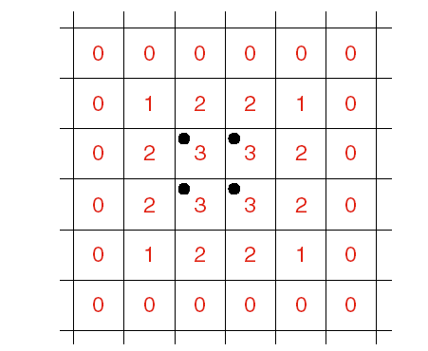
Examples --2
Stable example
Each of the living cells has a neighbor count of three, and hence remain alive, but the dead cells all have neighbor counts of two or less, and hence none of them becomes alive.
Notes:
top left corner
upper left
lower left

Slide 8
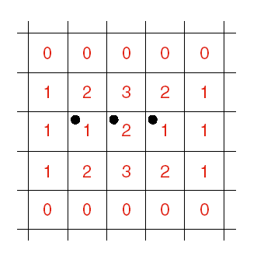
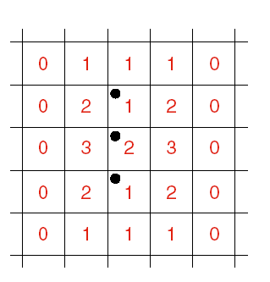
Examples --3
Alternate examples:
The two configurations continue to alternate from generation to generation.
Notes:
Current grid

Slide 9
Variety(多样化)
Through many generation, a simple initial configuration
  grow into large configurations,
  die out,
  reach a state where they do not change
  Go through a repeating pattern every few generations.
Our goal
Write a program that will show how an initial configuration will change from generation to generation .
Notes:
What to do？

Slide 10
the solution: classes ,objects and methods
Set up a Life configuration as an initial arrangement of living and dead cells.
Print the Life configuration.
While the user wants to see further generations:
  Update the configuration by applying the rules of the Life game.
  Print the current configuration.
Notes:
How to do？
how to store every configuration?
what operation we needed?
initialize
print
update
Question->mathematic->implement
configuration /创建，打印，更新

Slide 11

Review of C++ elements
A class collects data and the methods used to access or change the data.
Such a collection of data and methods is called an object belonging to the given class.
Every C++ class consists of members that represent either variables (called data members) or functions (called methods or member functions). The member functions of a class are normally used to access or alter the data members.
Example:
For the Life game,
    Class: Life class
    Object: a configuration
    Method: initialize(), update() ,print()
Notes:
Here, C++ ,We read it as C Plus Plus and cpp for short.

Slide 12
Review of C++ elements
By relying on its specifications, a client can use a method without needing to know how the data are actually stored or how the methods are actually programmed. This important programming strategy known as information hiding.
Data members and methods available to a client are called public; further private variables and functions may be used in the implementation of the class, but are not available to a client.
Convention（约定）
Methods of a class are public.
Functions in a class are private.
Notes:
The visibility of public and private member

Slide 13
Life: The Main Program
#include “utility.h” //page 678-679
#include “life.h“//life类的定义部分
int main( ) // Program to play Conway's game of Life.
/*Pre: The user supplies an initial configuration of living cells.
Post: The program prints a sequence of pictures showing the changes in the configuration of living cells according to the rules for the game of Life.
Uses: The class Life and its methods initialize( ) ,print( ) , and update( ) .The functions instructions( ) ,user_ says_ yes( ) . */
Notes:
Sketch of the program

Slide 14
{
Life configuration;
instructions( );
configuration.initialize( );
configuration.print( );
cout << "Continue viewing new generations? " << endl;
while (user_says_yes( )) {
configuration.update( );
configuration.print( );
cout << "Continue viewing new generations? " << endl;
}
}

Slide 15
Utility Package(p678)
We shall assemble a utility package that contains various declarations and functions that prove useful in a variety of programs, even though these are not related to each other as we might expect if we put them in a class.
For example, we shall put declarations to help with error processing in the utility package.
Our first function for the utility package obtains a yes-no response from the user:
bool user_says_ yes( )
Pre: None.
Post: Returns true if the user enters ‘y’ or ‘Y’; returns false if the user enters ‘n’ or ‘N’; otherwise requests new response

Slide 16
Other C++ elements
Clients, that is, user programs with access to a particular class, can declare and manipulate objects of that class.
For example:declare a Life object by: Life configuration;
member selection operator We can now apply methods to work with configuration, using the C++ operator. For example, we can print out the data in configuration by writing:
configuration.print( );
The specifications of a method, function, or program are statements of precisely what is done. Preconditions state what is required before; postconditions state what has happened when the method, function, or program has finished.
Programming Precept
Include precise specifications
with every program, function, and method that you write.
Notes:
注意在这个主程序中所用到的c++中的一些概念和原理：
Let’s review the C++ elements we have encountered in the main program.
Client 客户程序 是一个用户编写的程序，它可以对某一个类进行访问，可以声明或者处理类中的对象。
For example , now the main program we have written is a client to the Life class.
我们使用C++的成员选择符（即.操作符）对configuration使用方法（method）,比如说我们可以使用configuration.print( );对configuration中的数据进行显示。

Slide 17

Example demonstration
——game of life
Coding
  1.Stubs（占位程序）
    To compile each function and class separately
    To compile the main program correctly, there must be something in the place of each function that is used, so put in short, dummy functions.——which named stubs
    the simplest stubs are those that do little or nothing at all:
      void instruction() {}
      bool user_says_yes() { return false;}
Notes:
大部分程序员会急于验证一下我的主程序是否能够运行。
第一种情况：普通的函数

Slide 18

Coding of game of life
2.Definition of the class Life
    const int maxrow=20,maxcol=60; //living cells共有20行，60列
    class Life{ //存放在*.h文件中的类体声明
    public:
    void initialize(); //初始化living cells的状态
    void print(); //打印输出当前living cells的状态
    void update(); //进行dead⬄living间的转换
    private:
    int grid[maxrow+2][maxcol+2]; //借助两维数组存放living cells
    //注意：为处理一致，添加了虚拟的2行2列，放围墙
    int neighbor_count(int row,int col); //统计邻居cell的状态
    };

Slide 19
Stub example2:
To check if the class definition is correct, We should supply the following stubs for its methods in life.cpp:
void Life :: initialize( ) {}
void Life :: print( ) {}
void Life :: update( ) {}

Slide 20
Instructions
void instructions( )
/* Pre: None.
Post: Instructions for using the Life program have been printed. */
{
cout << "Welcome to Conway’s game of Life." << endl;
cout << "This game uses a grid of size "
<< maxrow << " by " << maxcol << " in which each" << endl;
cout << "cell can either be occupied by an organism or not." << endl;
cout << "The occupied cells change from generation to generation"<< endl;
cout << "according to how many neighboring cells are alive."<< endl;
}

Slide 21
user_says_yes( )
bool user_says_yes( )
{
int c;
bool initial_response = true;
do { // Loop until an appropriate input is received.
if (initial_response)
cout << " (y,n)? " << flush;
else
cout << "Respond with either y or n: " << flush;
do { // Ignore white space.
c = cin.get( );
} while (c == ‘\n’ || c == ‘ ’ || c == ‘\t’);
initial_response = false;
} while (c != ‘y‘ && c != ‘Y‘ && c != ‘n‘ && c != ‘N‘);
return (c == ‘y‘ || c == ‘Y‘);
}

Slide 22
Functions and Methods of class Life
3.Counting neighbors:
  sentinel（岗哨）(hedge): A sentinel is an extra entry put into a data structures so that boundary conditions need not be treated as a special case.
  int Life::neighbor_count(int row,int col){
  int i,j,count=0;
  for (i=row-1;i<=row+1;i++)
  for (j=col-1;j<=col+1;j++)
  count+=grid[i][j];//如果存活，则累加；否则为0
  count-=grid[row][col]; //去除自己
  return count;
  }

Slide 23
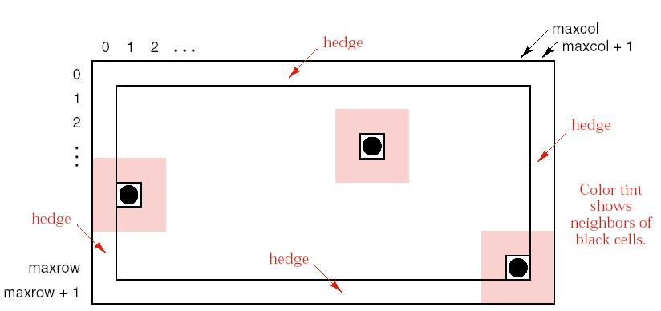

Slide 24
Functions and Methods of Class Life
4.Updating the grid
  void Life::update(){
  int row,col,new_grid[maxrow+2][maxcol+2];
  for (row=1;row<=maxrow;row++)
  for (col=1;col<=maxcol;col++)
  switch(neighbor_count(row,col)){//调用统计函数,按结果分情况
  case 2: new_grid[row][col]=grid[row][col]; break;//不变
  case 3: new_grid[row][col]=1; break; //激活
  default: new_grid[row][col]=0; //dead
  }
  for (row=1;row<=maxrow;row++)
  for (col=1;col<=maxcol;col++)
  grid[row][col]=new_grid[row][col];
  //将临时数组中的数据拷贝回原grid数组
  }

Slide 25
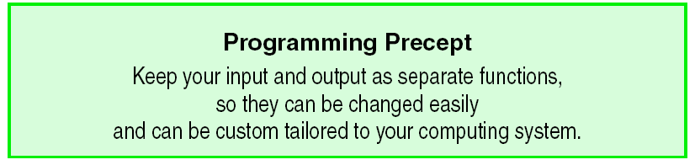
Functions and Methods of Class Life
5.Input and Output:

Slide 26
Functions and Methods of Class Life
Input——initialize
  void Life::initialize(){
  int row,col;
  for (row=0;row<=maxrow+1;row++)
  for (col=0;col<=maxcol+1;col++)
  grid[row][col]=0;
  cout<<“List the coordinates for living cells.”<<endl;
  cout<<“Terminate the list with the special pair (-1,-1)”<<endl;
  cin>>row>>col;
  while (row!=-1||col!=-1){
  if (row>=1&&row<=maxrow)
  if (col>=1&&col<=maxcol) grid[row][col]=1;
  else cout<<“Column “<<col<<“ is out of range.”<<endl;
  else cout<<“Row “<<row<<“ is out of range.”<<endl;
  cin>>row>>col;
  }
  }

Slide 27
Functions and Methods of class Life
Output——print:
    void Life::print(){
    int row,col;
    cout<<“\nThe current Life configuration is: “<<endl;
    for (row=1;row<=maxrow;row++){
    for (col=1;col<=maxcol;col++)
    if (grid[row][col]==1) cout<<“ * ”;
    else cout<<“ ”;
    cout<<endl;
    }
    cout<<endl;
    }
    }

Slide 28
Functions and Methods of Class Life
6.Drivers:
  Driver is a short auxiliary program whose purpose is to provide the necessary input for the function, and evaluate the result——so that each function can be isolated and studied by itself.

Slide 29
Example 1:driver for neighbor_ count():
int main ( ) // driver for neighbor_count( )
/* Pre: None.
Post: Verifies that the method neighbor_count ( ) if it returns the correct values.
Uses: The class Life and its method initialize( ) . */
{
  Life configuration;
  configuration.initialize( );
  for (row = 1; row <= maxrow; row++) {
  for (col = 1; col <= maxrow; col++)
  cout << configuration.neighbor_count(row, col) << " ";
  cout << endl;
}
}

Slide 30
Example 2 :driver for initialize() and print():
Sometimes two functions can be used to check each other.
configuration.initialize( );
configuration.print( );
Both methods can be tested by running this driver and making sure that the configuration printed is the same as that given as input.

